Slide 1
React & Redux
Keep your head cool and focused, there’s a tons of stuff to see today
Cedric Hartland

Slide 2
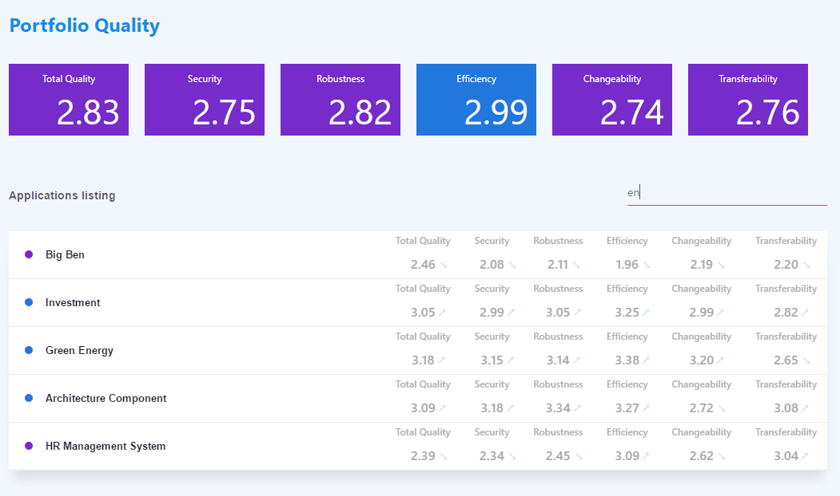
A project we’re targeting

Slide 3
React – a gentle introduction
Javascript library for building user interfaces

Slide 4
React – a library that defines views through components
In a declarative way
Components (objects…) means reusability
Given an application state, renders some shadow DOM application state are inputs named properties
Business logic, state flow and DOM rendering are independent
Optimized rendering engine inspired from game engines
Little assumption on application structure can “easily” integrate with other technologies
Can render on server side SEO please
What else ? Not so much

Slide 5
React – what’s actually good in it ?
Components
Enhanced reusability well, keep it generic if you plan on reusing…
Rendering lifecycle with optimizations
Basic type checking not so basic with propTypes
Becomes powerful with ES6 and more it’s not react, it’s ES6
Dependency management
Uptaded syntax and language features
Css inclusions
Arguably JSX
As opposed to string based templates

Slide 6
React – JSX
Update to JS – ease the code readability for React
Elements, expressions, functions, etc.
CSS horror !! Js based CSS injection, prefer CSS imports/modular CSS
ES5
JSX
React.createElement(
"div",
{ "class": "app-head" },
React.createElement("h1", null, "Portfolio Quality" ),
React.createElement(
Tiles,
{ color: "blue" },
React.createElement(Tile, { value: 2.8294564, title: "Total quality" }),
React.createElement(Tile, { value: 2.75189, title: "Security" }),
React.createElement(Tile, { value: 2.82154, title: "Robustness" }),
React.createElement(Tile, { value: 2.98678, title: "Efficiency" }),
React.createElement(Tile, { value: 2.74234, title: "Changeability" }),
React.createElement(Tile, { value: 2.76354, title: "Transferability" })
)
);
<div class="app-head" >
<h1>Portfolio Quality</h1>
<Tiles color="blue" >
<Tile value={2.8294564} title="Total quality" />
<Tile value={2.75189} title="Security" />
<Tile value={2.82154} title="Robustness" />
<Tile value={2.98678} title="Efficiency" />
<Tile value={2.74234} title="Changeability" />
<Tile value={2.76354} title="Transferability" />
</Tiles>
</div>

Slide 7

A (not so) simple component
class Tile extends React.Component {
static propTypes = {
value: React.PropTypes.number,
title: React.PropTypes.string
};
render() {
return ( <div className="tile">
<div className="tile-header">{this.props.title}</div>
<div className="tile-value">{numeral(this.props.value).format('0.00')}</div>
</div>
);
}
}
Reusable class or function
Js Expressions in brackets
Properties types
Optional parenthesis wrapping
JSX declarations

Slide 8
Using this component
<div className="tiles">
<Tile value={2.8294564} title="Total quality" />
<Tile value={2.75189} title="Security" />
…
</div>
Properties
passed explicitely
to the component
Reuse component as an html element
From collection of data to collection of components
<div className="tiles">
{data.map((sample, index) => {
return <Tile key={index} {...sample} />;
})}
</div>
Properties are submitted implicitely from object
Key is required for collections
So React can omptimize re-rendering

Slide 9

Adding user interactions
class Filter extends React.Component {
…
render() {
return (
<div className="filter-input">
<input
type="text"
value={this.props.filterText}
placeholder={this.props.placeholder}
onChange={this.props.handleFilter}
/>
</div>);
}
}
Bind functions to events
Beware, binding to this use ES6 !

Slide 10
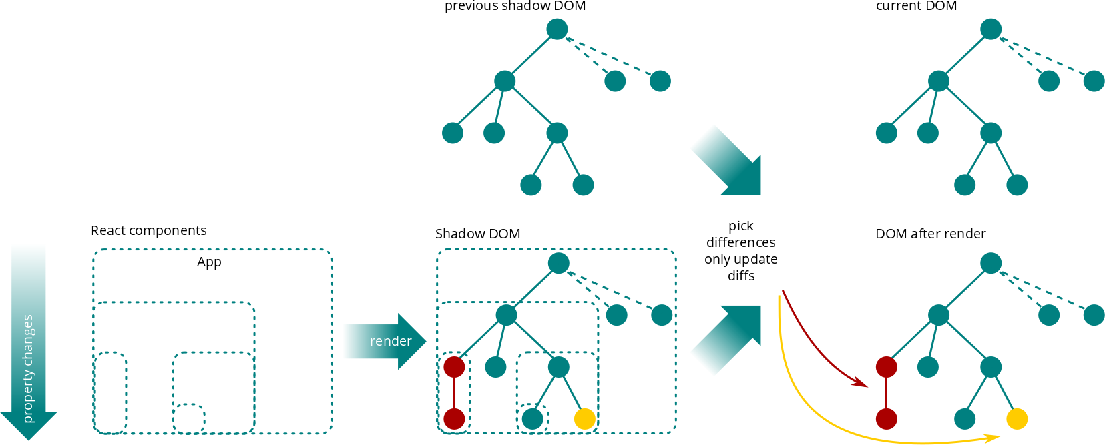
(re-)Rendering workflow

Slide 11
A few words on performance
Mounting (first render) is not cheap estimated x5 times slower than jquery
Creation of shadow DOM
Rendering of shadow DOM elements to actual DOM
Updating state
Component properties (inputs) changes trigger re-rendering comparing properties has negative impact on performance
Rendering creates a shadow DOM little impact on performance
Compare new shadow DOM to previous one negative impact on performance
Rendering of only differences to actual DOM strong positive impact on performance
Optimize via shouldComponentUpdate
Bring business logic and guess whether the component should call render at all not rendering when data are not changing has positive impact on performance

Slide 12
React
A few words before moving to next topic…
…just in case it was not that clear
React is designed in a declarative way
It can define it’s own internal state, but…
...most components should always return same content for given input and not have internal state dumb components, pure components
State only comes from data properties, state
No more jquery, backbone or whatever rendering tweaks on user interactions or from other sources
A single DOM source of truth is the output of render function
Application state only belong in data properties, state, dom reflects this

Slide 13
React – dumb & smart components
Application state is not held in component
Many components are said to be dumb
only display data
Dispatch events from user actions
Some smarter components
Operate other components and user actions functions
Some bind to data-source to manage application state updates

Slide 14
React & Redux
Rock & Roll

Slide 15
Redux – what the flux ?
React consumes data and produce DOM React updates DOM when data changes
Need for a data-source management workflow
Single source of truth
Whole application state in the centralized data store not hidden in DOM or other weird places
Flux, the original worflow :
Action
Dispatcher
View
Store

Slide 16
Redux – what the flux ?
React takes data and produce DOM
Need for a data-source-management workflow
Single source of truth
Flux, the worflow more in details
Dispatcher
Actions
Callbacks
Web API
Web API Utils
Action creators
Store
User Interactions
React views
Change events / Store queries

Slide 17
Redux - workflow close to that of flux
Motivation
MVC makes it hard to understand & debug application model update another model, then update a view that update a model, then…
SPAs high complexity data, interactions, asynchronicity, routing, etc. data mutation and asynchronicity makes it hard to reason about the application
Core principles
Single source of truth
The state of application stored in single object tree in single data store
State is read-only
Changing state requires an action that describes operation
Changes are made with pure functions
New state is new object no mutations

Slide 18
Redux – flux
Store is defined through
State
Reducers state mutator functions
Consumes current state
Consumes actions operations that could update state
Produces new state …or return the previous state if not changed
(state, action) → state’
Reducers can be combined
Divide & conquer
Reducers have to be pure functions
If states are different, their reference pointer are different
Benefit from predictability and testability
No need for deep object comparison through components lifecycle save on most expensive operation

Slide 19
Redux – workflow
Action
Dispatcher
View
Store

Slide 20
Redux – workflow
Action
Dispatcher
Store
Reducers
R
R
View
R
State

Slide 21
Redux – workflow
Dispatcher
API
Action
middlewares
Logs
Delay actions
Store
Loop actions
Reducers
Crash report
R
R
R
…
View
State

Slide 22
Redux – workflow
Dispatcher
API
Action
middlewares
Logs
Delay actions
Store
Loop actions
event
Reducers
Crash report
R
R
R
…
View
State

Slide 23
Redux – workflow
action
Dispatcher
API
Action
middlewares
Logs
Delay actions
Store
Loop actions
Reducers
Crash report
R
R
R
…
View
State

Slide 24
Redux – workflow
action
API
Dispatcher
Action
middlewares
Logs
Delay actions
Store
Loop actions
Reducers
Crash report
R
R
R
…
View
State

Slide 25
Redux – workflow
Dispatcher
API
Action
middlewares
Logs
action
Delay actions
Store
Loop actions
Reducers
Crash report
state
R
R
R
…
View
State

Slide 26
Redux – workflow
Dispatcher
API
Action
middlewares
Logs
Delay actions
Store
Loop actions
Reducers
Crash report
R
R
R
…
View
State
new state

Slide 27
Redux – workflow
Dispatcher
API
Action
middlewares
action
Logs
Delay actions
Store
Loop actions
Reducers
Crash report
R
R
R
…
View
State

Slide 28
Redux – workflow
action
API
Dispatcher
Action
middlewares
Logs
Delay actions
Store
Loop actions
Reducers
Crash report
R
R
R
…
View
State

Slide 29
Redux – workflow
Dispatcher
API
Action
middlewares
Logs
action
Delay actions
Store
Loop actions
Reducers
Crash report
state
R
R
R
…
View
State

Slide 30
Redux – workflow
Dispatcher
API
Action
middlewares
Logs
Delay actions
Store
Loop actions
Reducers
Crash report
R
R
R
…
View
State
new state

Slide 31
Redux – reducers and combinations
One reducer a
State will be state = { a: {…} }
When reducer a activates, it’s input state is not state but state.a
Combine 2 reducers (a, b)
State will be state = { a: { … }, b: { … } }
Reducer a consumes state.a and reducer b state.b
Combine and sub-combine a, (b, c)
State will be
state = { a: { … }, bc: { b: { … }, c: { …} } }
or state = { a: { … }, b: { … }, c: { …} }
Reducer bc can exist as a sliced reducer that has access to state.b & state.c

Slide 32
Redux – Data normalization
Different reducers work on different state data
Complex data structures may require elaborate operations
Share actions across reducers
Data duplication across reducers
Those require extra synchronization effort when writing or updating code
Accessing data may not be easy or consistent by default
Normalizing data can help normalizr
Relational mapping to structure data client side database !
Remove data duplication
Separate collections from elements

Slide 33
Application structure
sources
api/ // contains url information (builders) to (RESTful) API resources
business/ // contains data description and manipulations (redux workflow)
components/ // contains React dumb components
containers/ // contains React smart components
core/ // general application configuration skeleton
index.html // SPA entry point
main.jsx // SPA code entry point
store.js // redux data store setup

Slide 34
Business logic
sources
…
business/
any-concept/
specs/ // tests for business files, may be flat to folder or in such subfolder
actions.js // action creators (business logic operations there)
constants.js* // reusable constants (e.g. action variables)
reducers.js // reducer functions
sagas.js* // sagas middleware operations
..middleware.js // other possible middleware linked to business logic concept
…
Components with * are optional depending on context

Slide 35
Wait, there’s more
Build, enhanced development process and how to test

